Slide 1

Chapter 1:
Introduction to R Programming for Data Science
Notes:
https://www.powershow.com/view4/6deca5-MTg3Z/Data_Analysis_Using_R_1_Introduction_to_the_R_language_powerpoint_ppt_presentation
https://slideplayer.com/slide/13771452/
n

Slide 2
Getting Data into R 3

Slide 3
Objective
Work with arrays and matrices in the R programming language
Create a data frame in the R programming language, as well as how to access data and make changes.

Slide 4

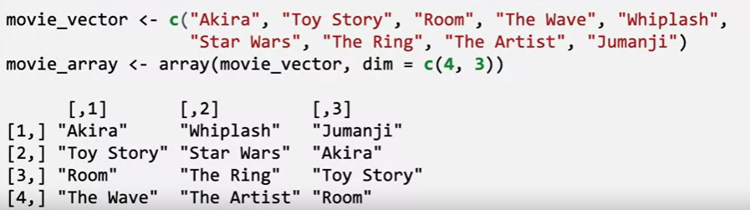
Array
An array is a structure that contains data of the same type such as strings, characters, or integers.
Arrays can be multi-dimensional so the data can be contained in multiple rows and columns
Create an array in R
Example

Slide 5

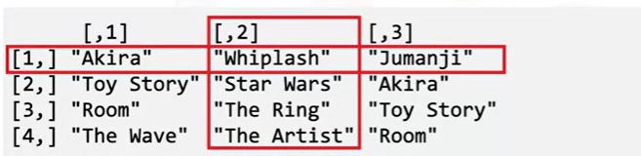

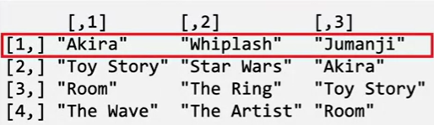
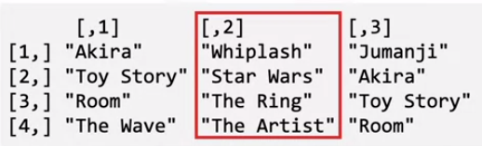
Array
Access an element
Access an entire row or column

Slide 6
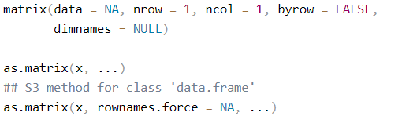
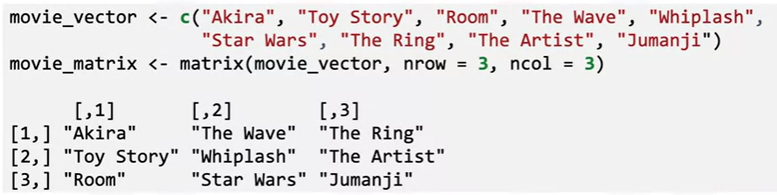
Matrices
A matrix is similar in structure to an array but it has two dimensions
Create a matrix in R
Example

Slide 7
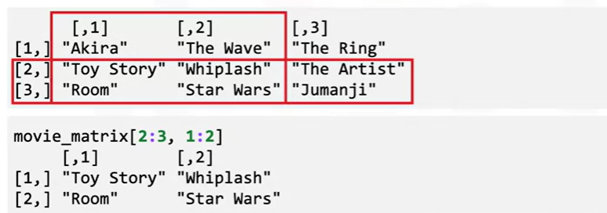
Matrices
Chapter1- Importing Datasets

Slide 8


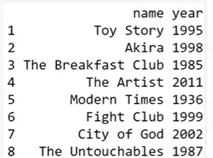
Data frames
A data frame is a type of structure that contains correlated information
Create a data frame in R
Example
Notes:
https://bookdown.org/ndphillips/YaRrr/what-are-matrices-and-dataframes.html

Slide 9
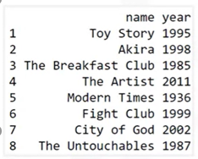

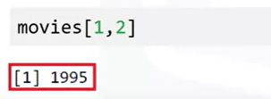
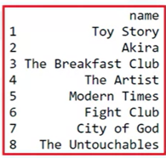
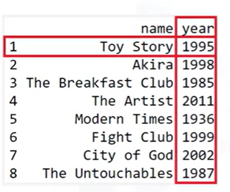
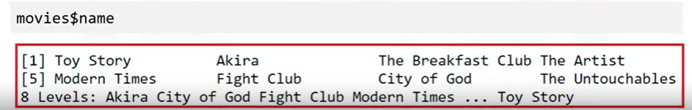
Data frame
access the element
Original data
Access a column
Access an element
Access a variable

Slide 10

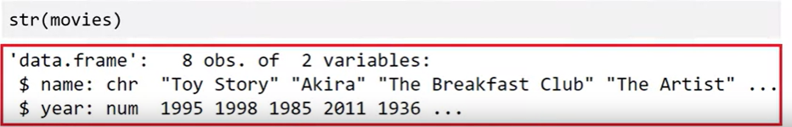
Data frame

Slide 11

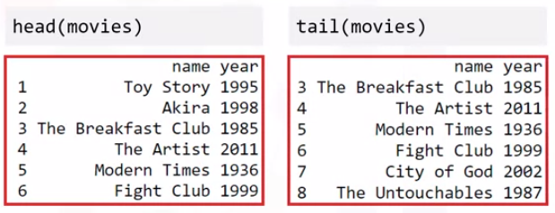
Data frame

Slide 12

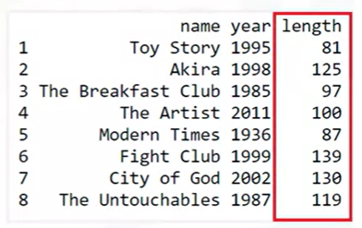
Data frame

Slide 13


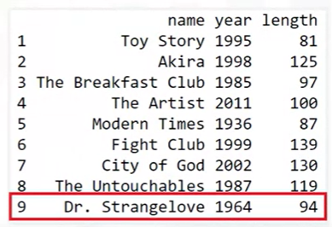
Data frame

Slide 14


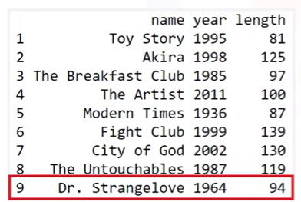
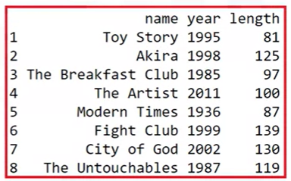
Data frame

Slide 15


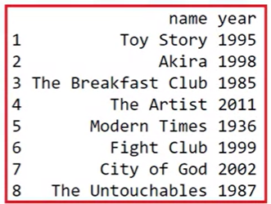
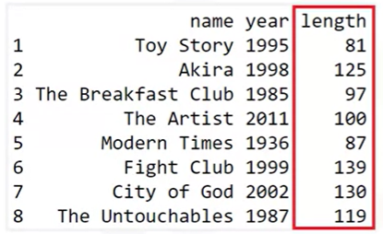
Data frame

Slide 16
Summary
At this point in the course, you know:
An array is a single or multidimensional structure containing data of the same type (strings, characters, or integers)
A matrix is like an array but must be two-dimensional and can be arranged by columns or rows.
The main difference between a data frame and other data structures, like a list, is that each variable has a vector of elements of the same type.

Slide 17
Q & A

